Slide 1
ZOOM CLONE
Presented By:
Kartik Kathuria (191500384)
Mridul Bhardwaj (191500462)
Jatin Kumar Singh (191500365)

Slide 2
OUTLINE
About the Project
Objective
Requirements
Snapshots from the website

Slide 3
ABOUT THE PROJECT
Over full stack project “Zoom Clone” is an online website which allows you to make account or conducting meetings according to schedules which you can decide as per your requirements.
It is used for telecommunication, social relations, education etc.

Slide 4
OBJECTIVE
Zoom (clone) objective is to provide virtual communication between two individuals or group of people. It is a open source free video conferencing platform that was developed by zoom video communications in 2011.

Slide 5
Software Specification Used:
Technology Used: MongoDB, ReactJS and NodeJS
IDE Used: Visual Studio Code
Web Browser: Google Chrome

Slide 6
Hardware Used:
Processor Used: Intel i3, i5
Operating System: Windows 8, 10
RAM: 3GB, 4GB
Hardware Devices: Computer System, Tablets
Hard Disk: 512 GB

Slide 7
THIS IS HOW THE WEBSITE
LOOKS LIKE
Hope you will like it ☺

Slide 8
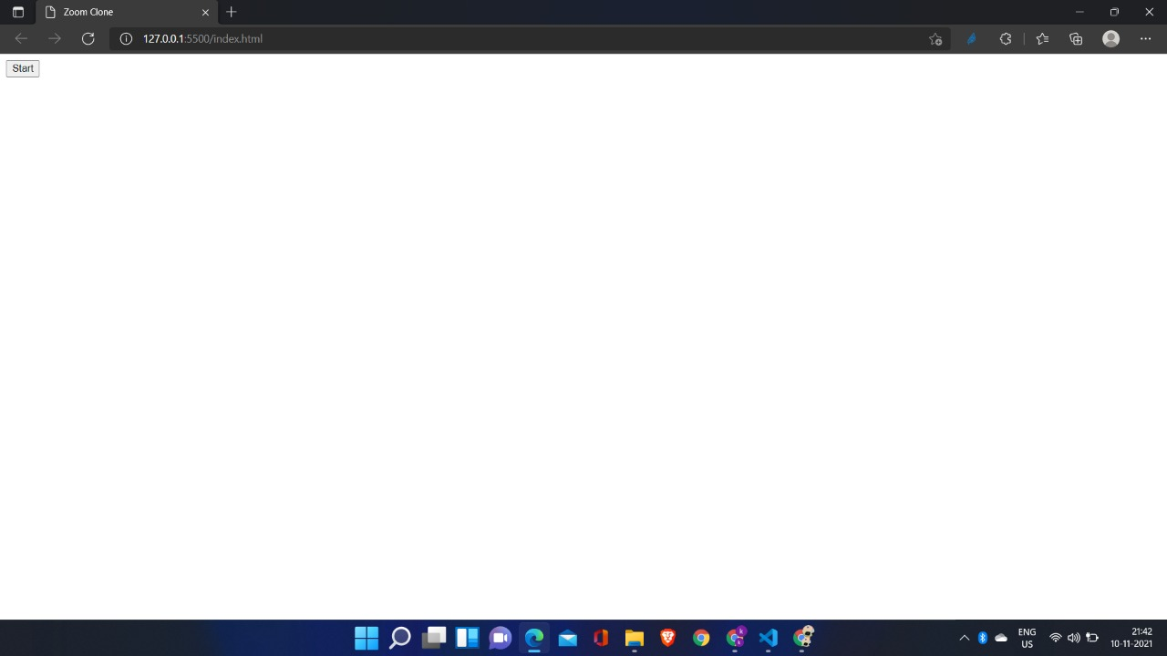
1.START PAGE

Slide 9
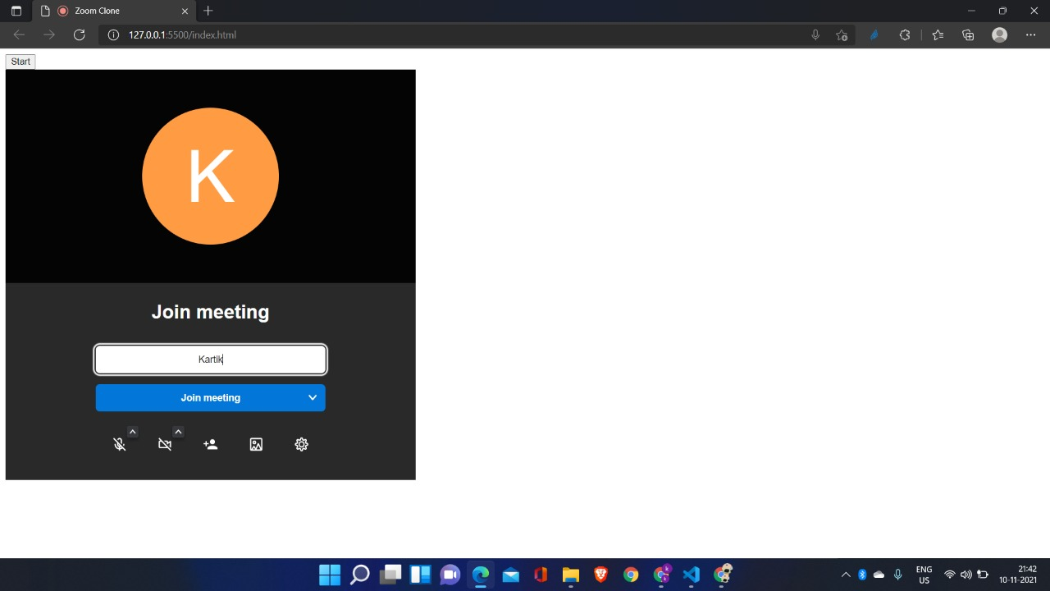
2. JOINING PAGE

Slide 10
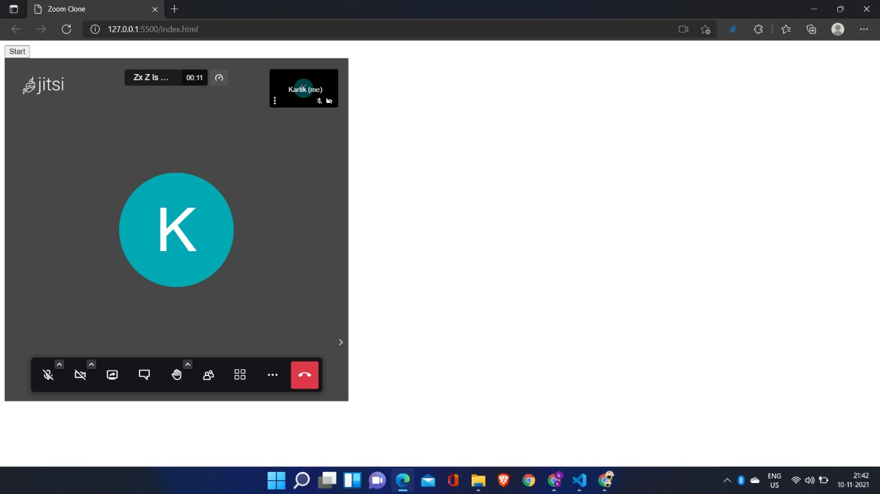
3. JOINED PAGE INTERFACES

Slide 11
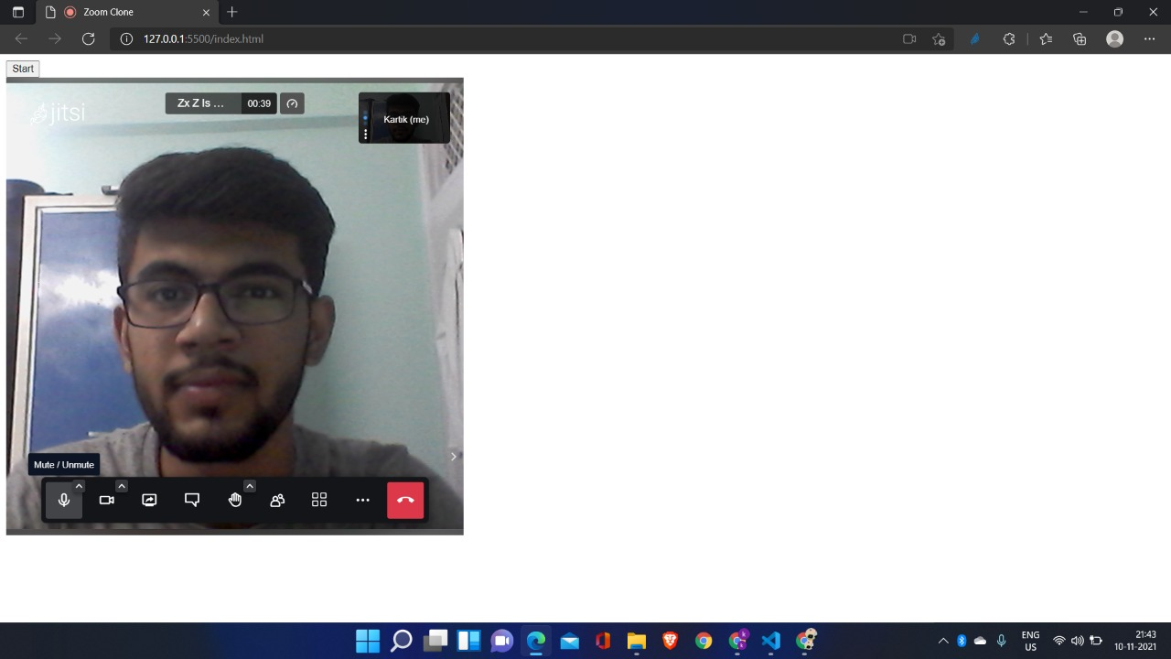
4.

Slide 12
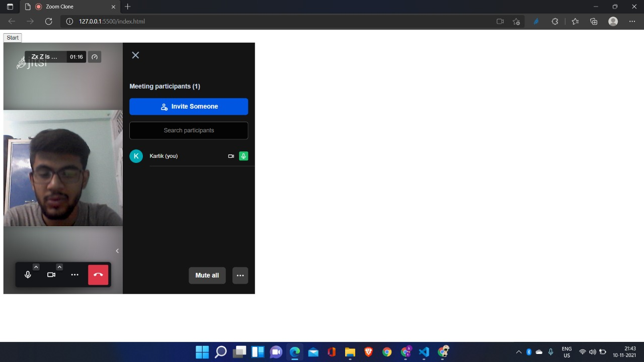
5.

Slide 13
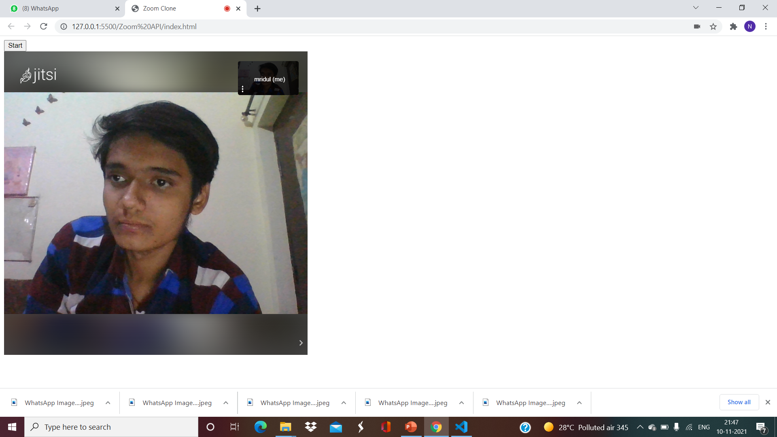
6.

Slide 14
THANK YOU!!!

